Slide 1


CRISIS DISPATCHER
A Serious Game-Based Platform for Emotional Regulation Assessment
Presented by
Evlin Sara Johny
Lakshmi Pramode

Slide 2

PROGRESS SINCE REVIEW 1
✔ Literature Review Completed
✔ Construct Map Prepared
✔ System Workflow Designed
✔ Event Logging & SDK Schema Finalized
✔ MVP Architecture Designed
✔ MERN Application Developed
✔ Serious Game Prototype Completed
✔ Behavioural Scoring Engine Implemented
✔ Admin Analytics Dashboard Completed

Slide 3

PROBLEM STATEMENT
Traditional emotional regulation assessment:
Questionnaire-based
Subjective
Response bias
No real-time behaviour analysis
Our Solution:
A simulation-based serious game that continuously records behavioural interactions during emergency response scenarios.

Slide 4
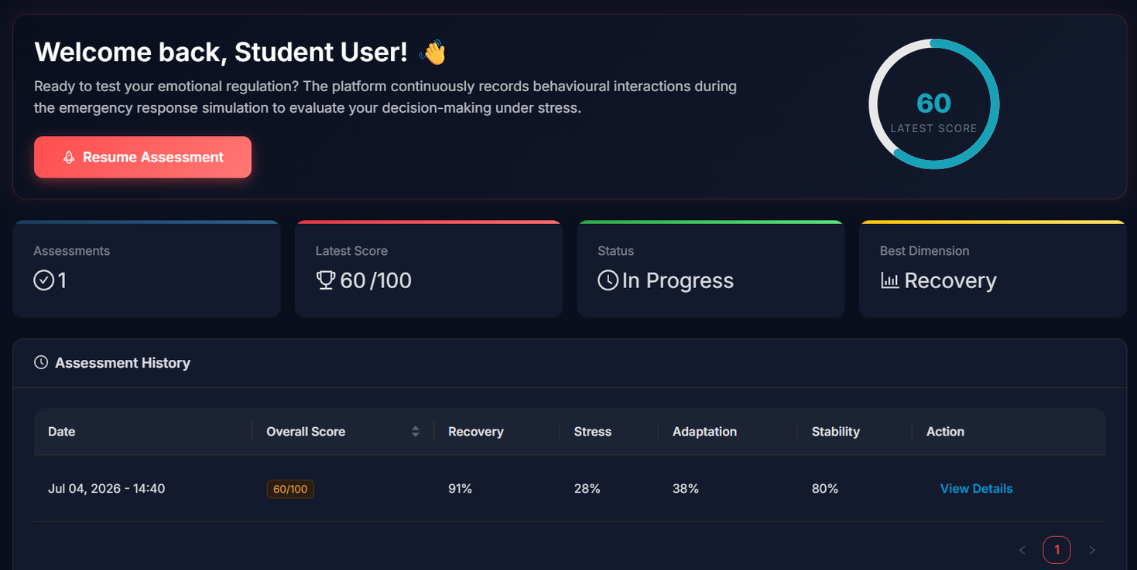

PROPOSED SYSTEM
TITLE: CRISIS DISPATCHER
Student acts as an Emergency Dispatcher.
The system continuously records:
Reaction Time
Decision Accuracy
Recovery Behaviour
Strategy Changes
Panic Behaviour
Student Dashboard

Slide 5
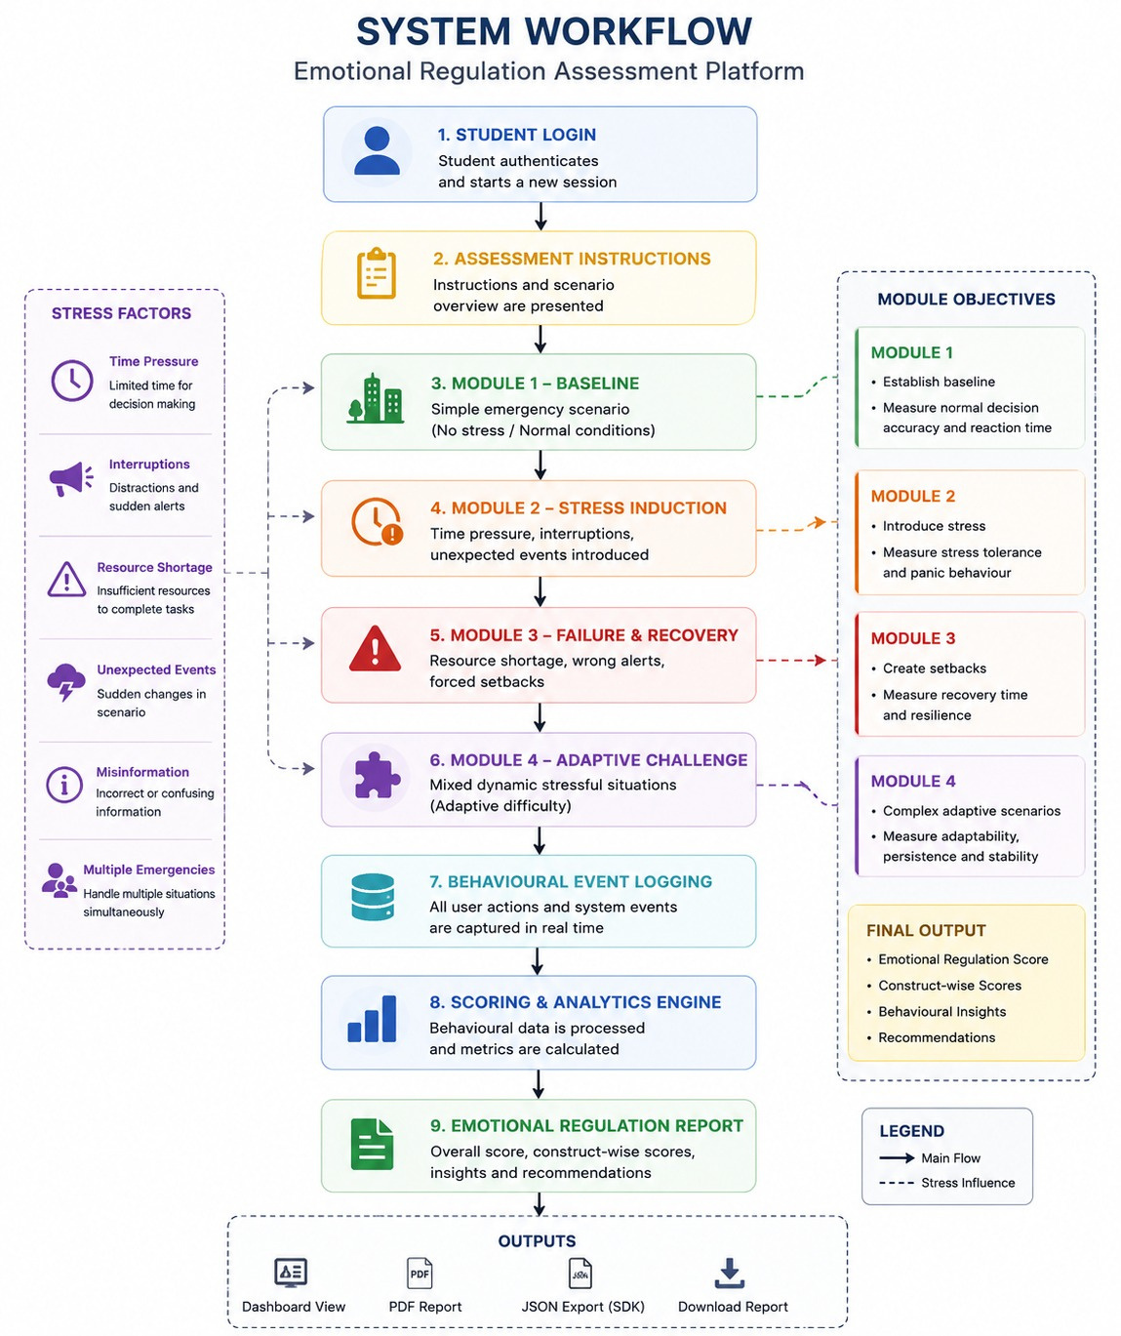

ASSESSMENT WORKFLOW

Slide 6

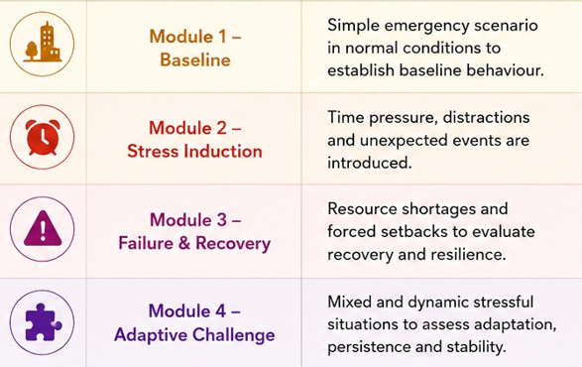
FOUR ASSESSMENT MODULES
MODULE | PURPOSE
Baseline | Normal decision making
Stress | Behaviour under pressure
Failure & Recovery | Resilience after setbacks
Adaptive Challenge | Cognitive flexibility

Slide 7
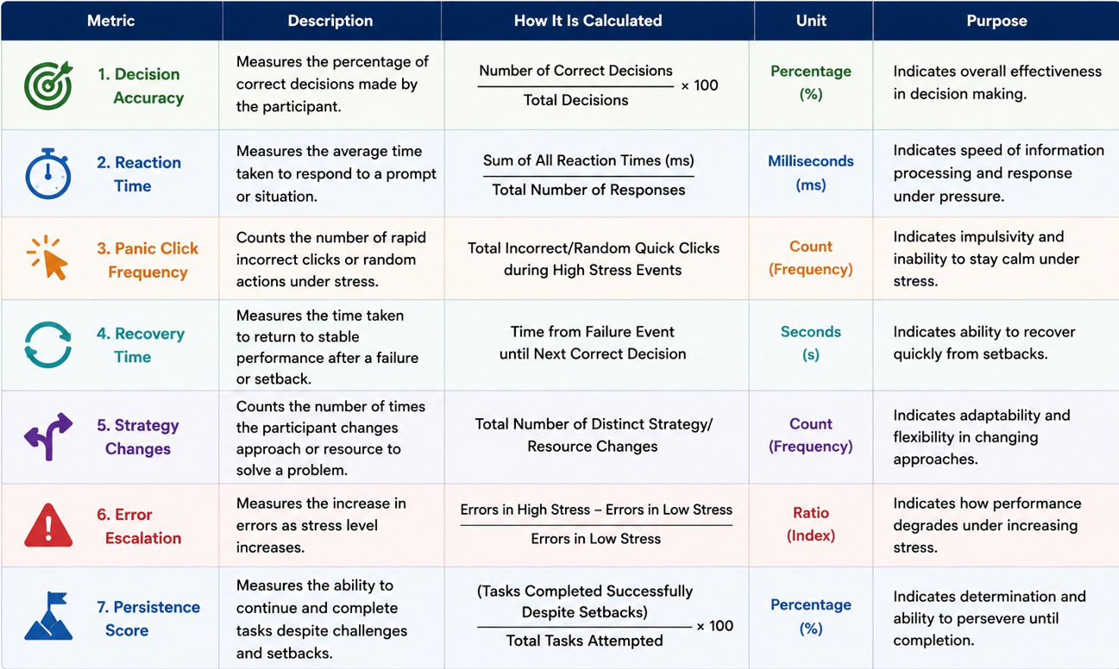
BEHAVIOURAL ANALYTICS

Slide 8

RECOVERY & RESILIENCE
30%
STRESS TOLERANCE
25%
BEHAVIOURAL SCORING
ADAPTATION & PERSISTENCE
25%
DECISION STABILITY
20%
FINAL SCORE
STUDENT RESULTS
ADMIN ANALYTICS

Slide 9
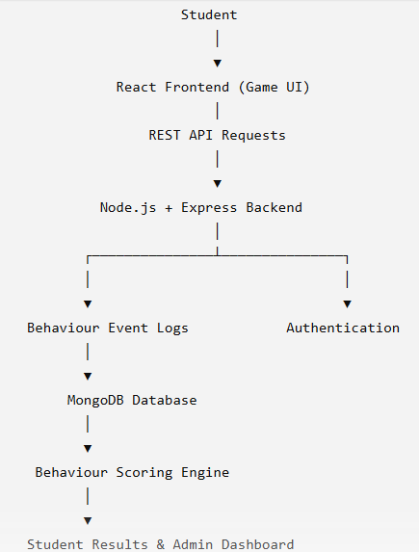

MVP ARCHITECTURE
Developed using MERN Stack.

Slide 10
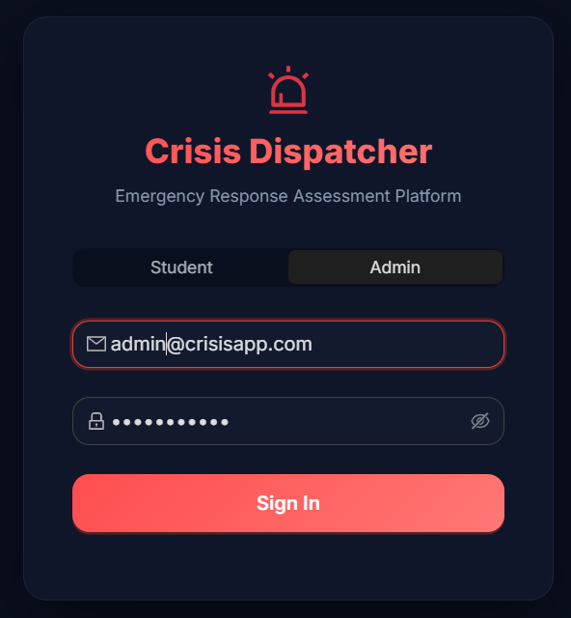
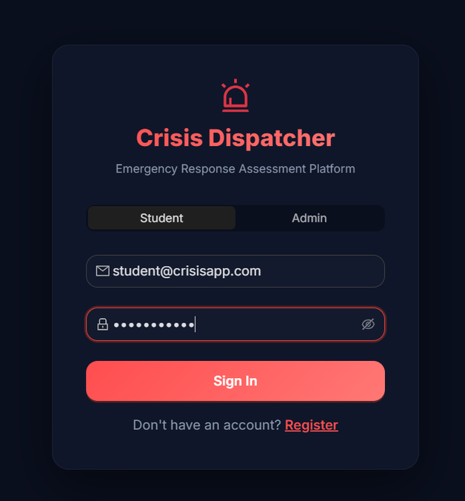
APPLICATION SCREENS
Login page

Slide 11
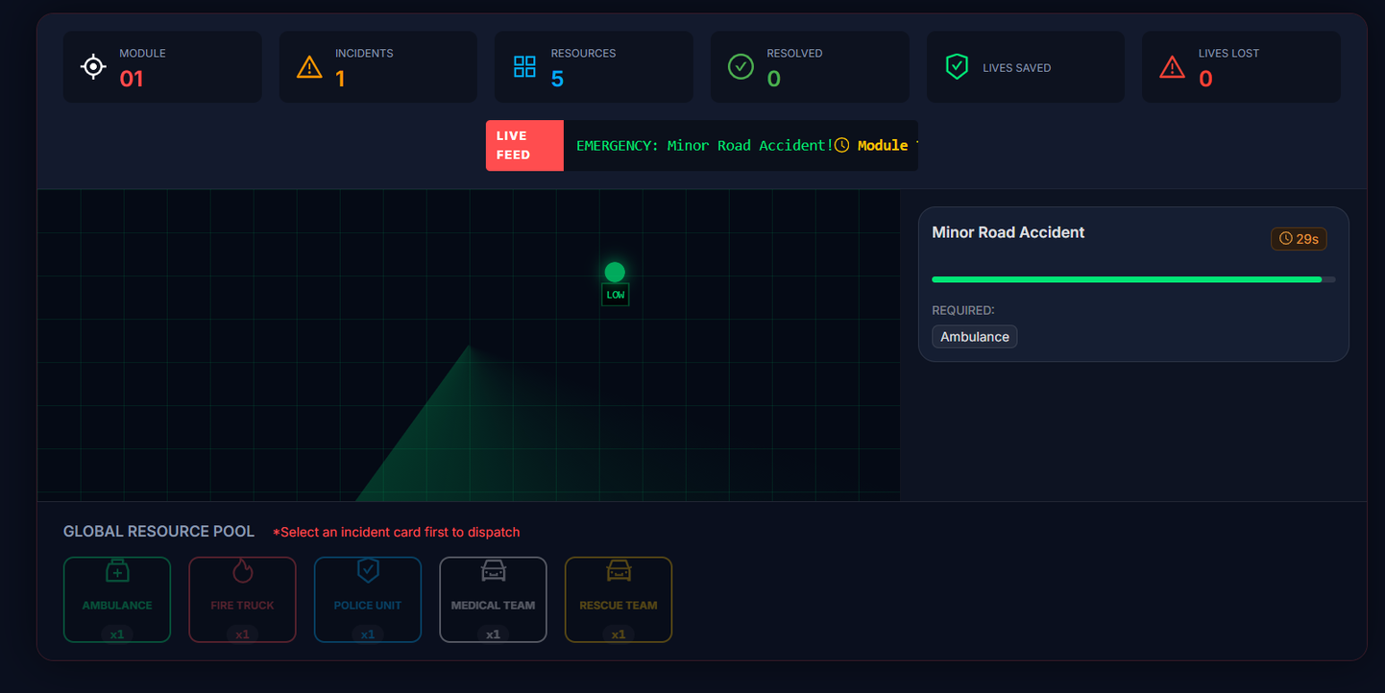
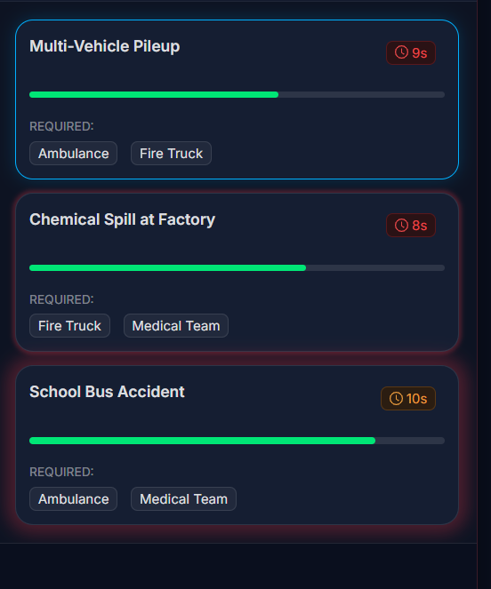
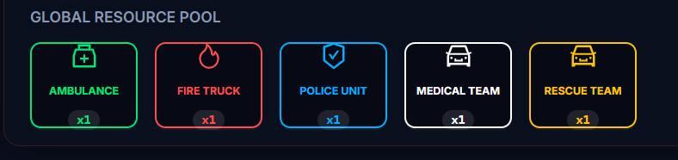
Radar Map
Incident Feed

Slide 12
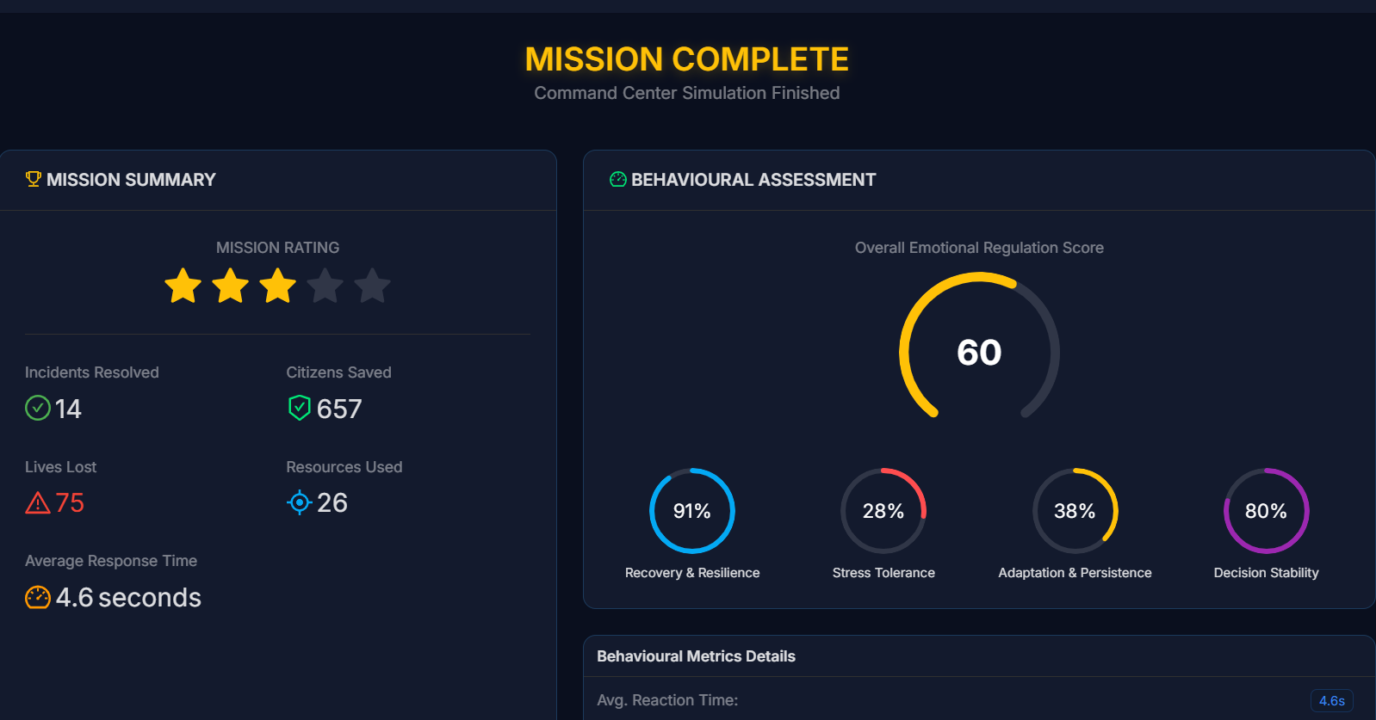
Results Page

Slide 13
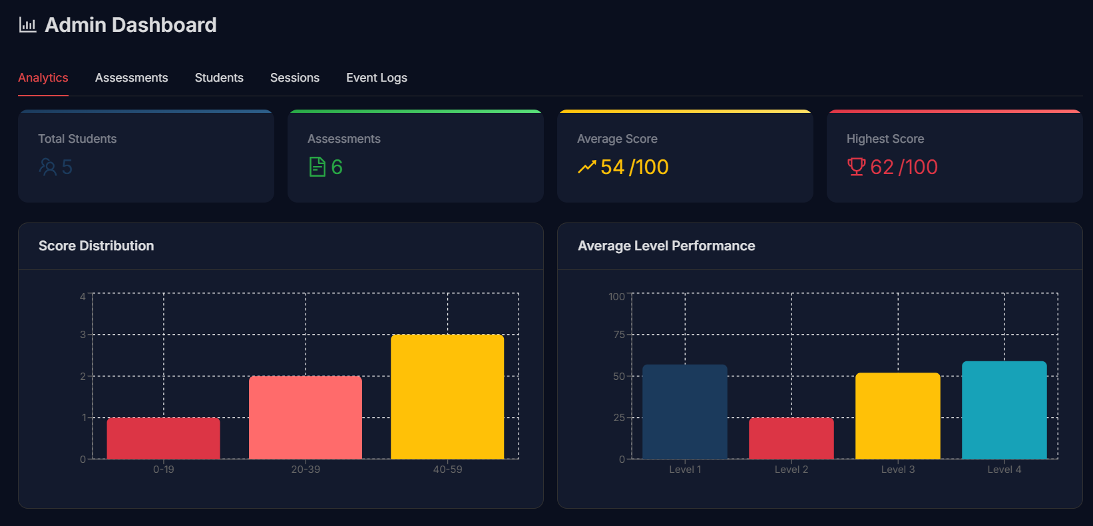
Admin Dashboard

Slide 14
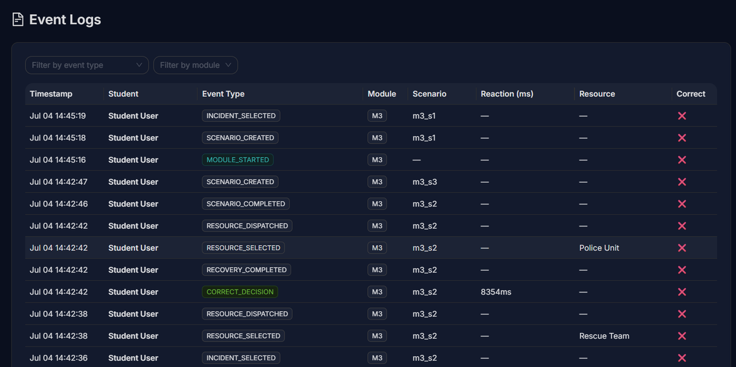
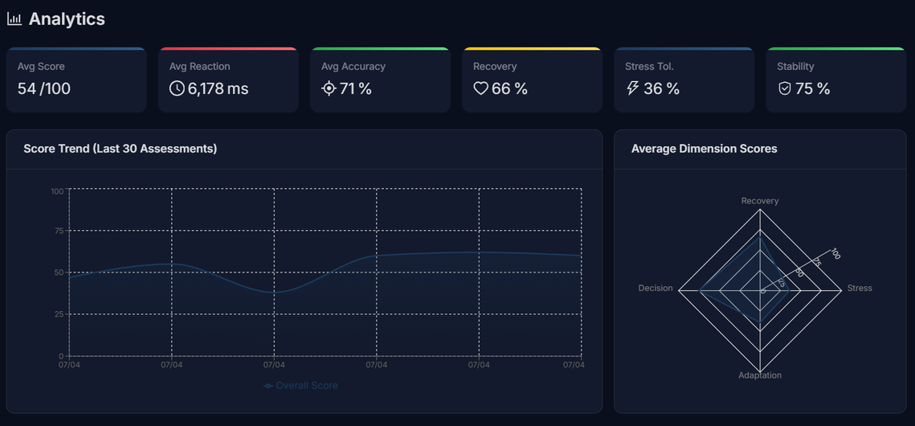
Behavioural Event Logs
Analytics

Slide 15
CURRENT STATUS
Literature Review
Construct Map
System Workflow
Event Schema
MVP Architecture
Frontend
Backend
Database
Scoring Engine
Admin Dashboard
Next Phase
Session Replay
Advanced Analytics
AI-based Behaviour Prediction
Mobile Support
Cloud Deployment
Overall Progress : ~95–100% MVP Completed
Live Demo: https://Acrisis-dispatcher.vercel.app/

Slide 16
THANK YOU

